Slide 1
Smart Vision for Safer Road & Real-Time Object Detection for “Smart” Vehicles
Presenters: Sakina Ishaq & Amanat Ali

Slide 2
Introduction
In today's fast-paced world, road safety remains a paramount concern. Accurate and real-time detection of road signs, as well as the recognition of all road related things and plays a pivotal role in maintaining safety and security on our roads. And it can be used in smart vehicles. The "Smart Vision for Safer Road" project seeks to address these issues by implementing a robust computer vision system.

Slide 3
Project Goals and Objectives:
The primary goals of this project are as follows:
- Develop a real-time computer vision system for the detection and recognition of road signs.
-Make a vehicle driverless.
- Enhance road safety by providing critical road-related information to drivers.
- Aid law enforcement agencies in traffic monitoring and violation detection.

Slide 4
Scope of Work:
The scope of work for the "Smart Vision for Safer Road" project includes the following components:
- Data collection and annotation of road signs and object on road like person .
- Model selection and training for object detection.
- Integration of the system into existing road infrastructure.
- Performance evaluation and optimization of the system.

Slide 5

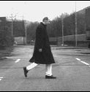
Edge-Based Target Recognition
What are we trying to achieve?
We want to determine the presence and location of a template T in an image I.
?
Edge-Template
(hand-drawn from footage, or automatically generated from CAD models)
Image Scene
Real world, real time video footage.

Slide 6
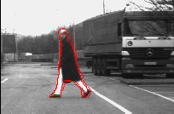
Let’s look at the application
Our Goal:
We want to assist the driver:
Avoid Pedestrians
Recognize Road Signs
Recognize Any other Vehicles on road

Slide 7
Methodology:
The "Smart Vision for Safer Road" project will utilize cutting-edge computer vision and machine learning techniques for object detection, including convolutional neural networks (CNNs) and deep learning frameworks. Real-time data processing will be a core component, ensuring timely recognition and analysis of road related things.

Slide 8
Expected Outcomes:
Upon completion, the project is expected to deliver the following outcomes:
-Best Option for Smarts Cars.
- Recognize Road Signs.
- Enhanced road safety through better information dissemination.
- Improved traffic monitoring and violation detection capabilities for law enforcement.

Slide 9
Conclusion:
The "Smart Vision for Safer Road" project represents a significant step forward in road safety and traffic management. By developing an advanced computer vision system for road sign and all road releated things, we are committed to making our roads safer and more secure for all.
It can be used in smart cars to detect obeject on road.

Slide 10
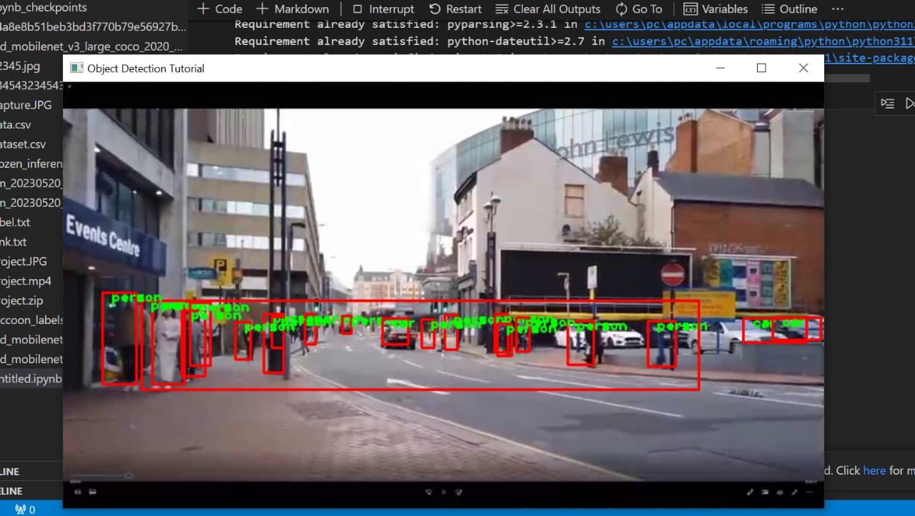
Final Overview Of Project

